Slide 1
X12 power conversion
Guillermo, Erin

Slide 2
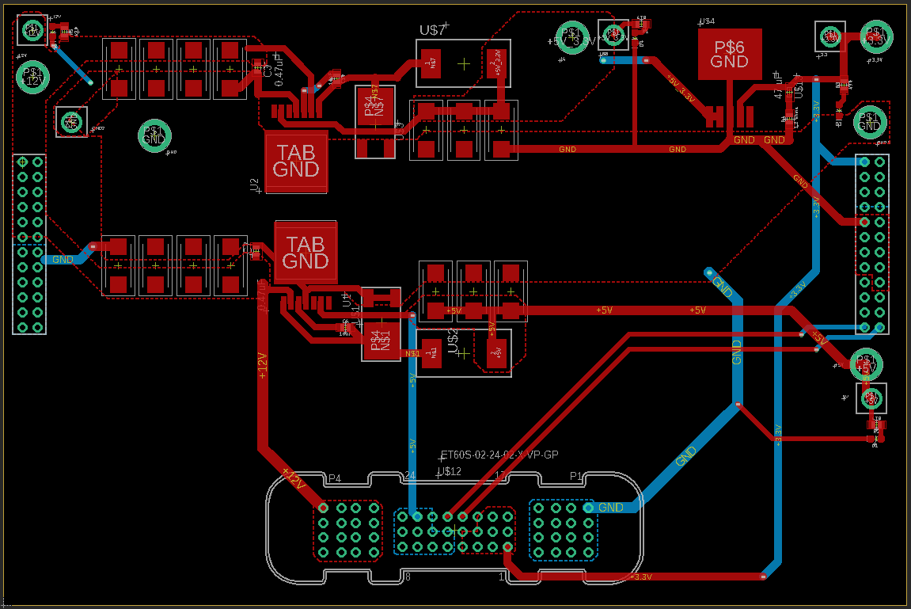

Slide 3
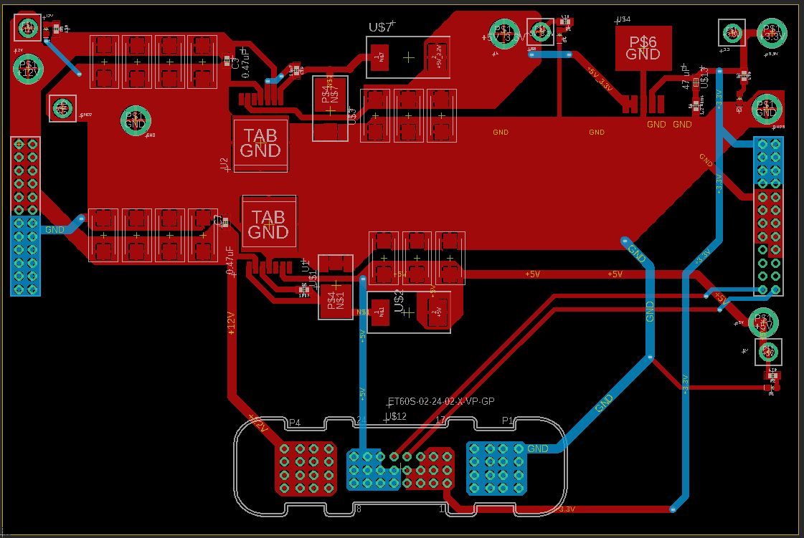

Slide 4
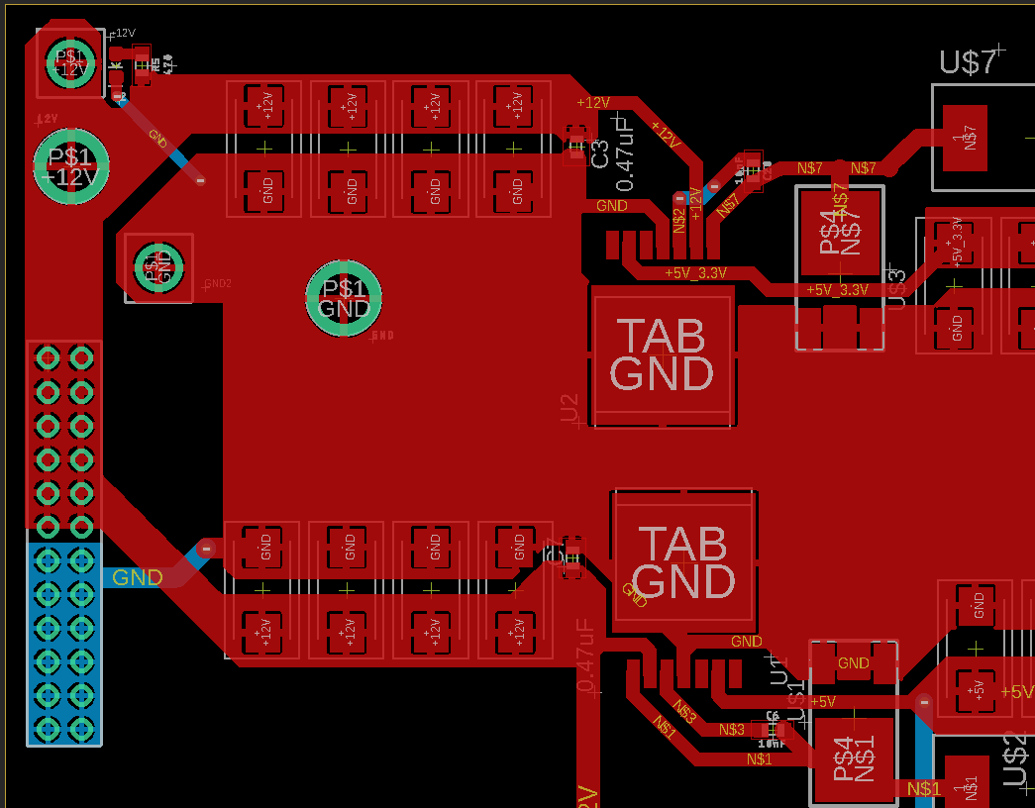
Test points + LED/resistor
12v plane
Ground plane
Some connectors

Slide 5
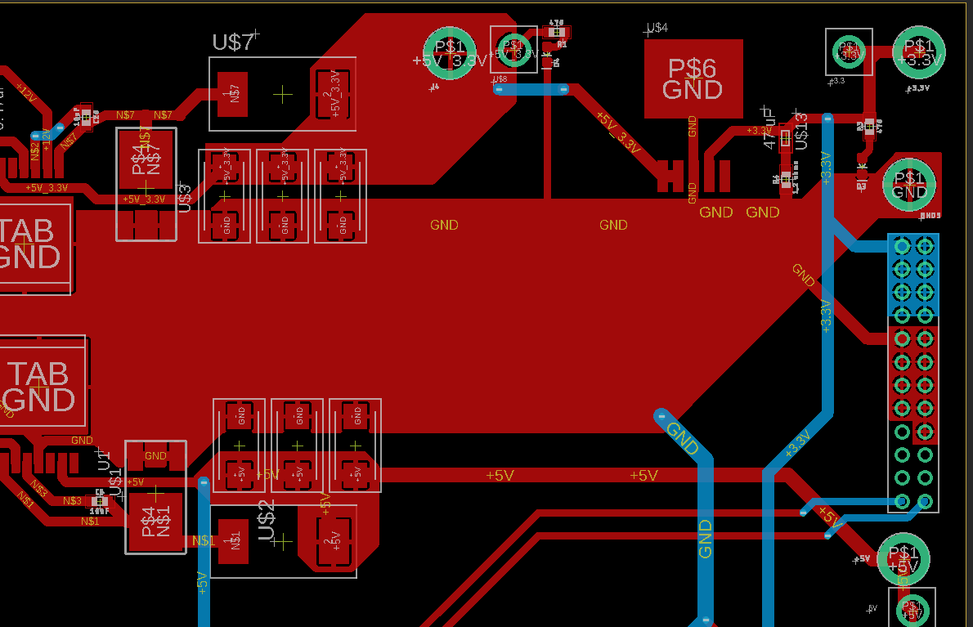
5v_3.3 plane
Linear regulator and 3.3v out
3.3v and ground connectors
5v plane and out

Slide 6
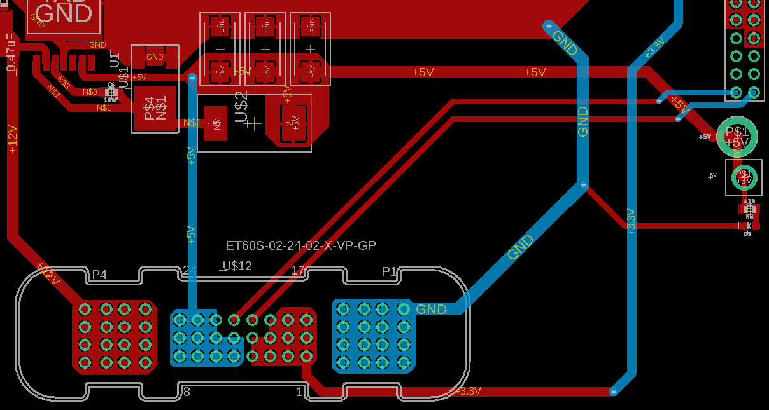
Bottom connectors, all the voltages + gnd are routed with can_high/low

